Slide 1

Customer Shopping Behavior Analysis
Uncovering insights from 3,900 purchases to guide strategic business decisions

Slide 2
Dataset Overview
3,900
18
4
50
Total Purchases
Data Points
Categories
Locations
Transactions analyzed
Features per transaction
Product segments
Geographic coverage
Customer Data
Transaction Details
Age, Gender, Location
Item, Category, Amount
Subscription Status
Season, Size, Color
Purchase History
Discounts & Promos

Slide 3
Data Preparation & Cleaning
01
02
03
Data Loading
Missing Data
Feature Engineering
Imported dataset using pandas, explored structure with .info() and .describe()
Imputed 37 missing Review Ratings using median by category
Created age_group bins and purchase_frequency_days columns
04
05
Standardization
Database Integration
Renamed columns to snake case, dropped redundant promo_code_used
Connected to PostgreSQL and loaded cleaned data for SQL analysis

Slide 4
Key Statistical Insights
Average Age
Purchase Amount
44 years old
$55.76 average
Range: 18-70
Range: $20-$100
Review Rating
Previous Purchases
3.75 average
25 average
Range: 2.5-5.0
Range: 1-50
Gender Split
Top Category
Subscription Rate
68% Male customers
Clothing most popular
27% subscribed

Slide 5
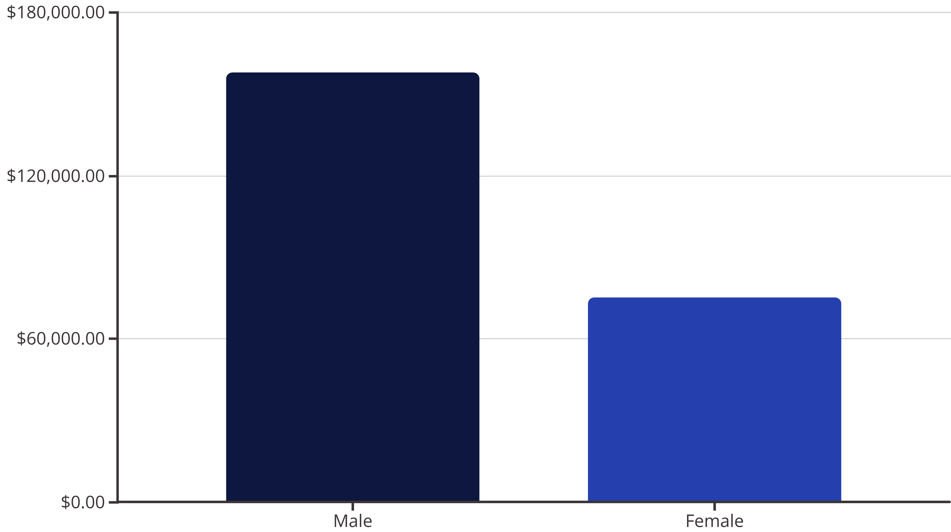
Revenue Analysis
Gender Revenue Gap
Total Revenue
Male customers generate 2.1x more revenue than female customers
$233,081 across all transactions

Slide 6







Customer Segmentation
Returning
701 customers
18% of base
Loyal
3,116 customers
80% of base
New
83 customers
2% of base
Segmentation based on purchase history: New (1-5 purchases), Returning (6-15), Loyal (16+)

Slide 7

Product Performance
Top Rated Products
Most Purchased by Category
Gloves (3.86)
Sandals (3.84)
Accessories: Jewelry (171)
Boots (3.82)
Clothing: Blouse (171)
Hat (3.80)
Footwear: Sandals (160)
Skirt (3.78)
Discount-Dependent Items
Hat (50%), Sneakers (49.7%), Coat (49.1%) have highest discount rates

Slide 8


Subscription & Loyalty Insights
27%
73%
Subscription Rate
Non-Subscribers
1,053 of 3,900 customers
2,847 customers
Average Spend Comparison
Repeat Buyers
Subscribers: $59.49
958 subscribers have 5+ purchases
Non-subscribers: $59.87
2,518 non-subscribers have 5+ purchases
Minimal difference in spending behavior
Opportunity to convert loyal non-subscribers

Slide 9
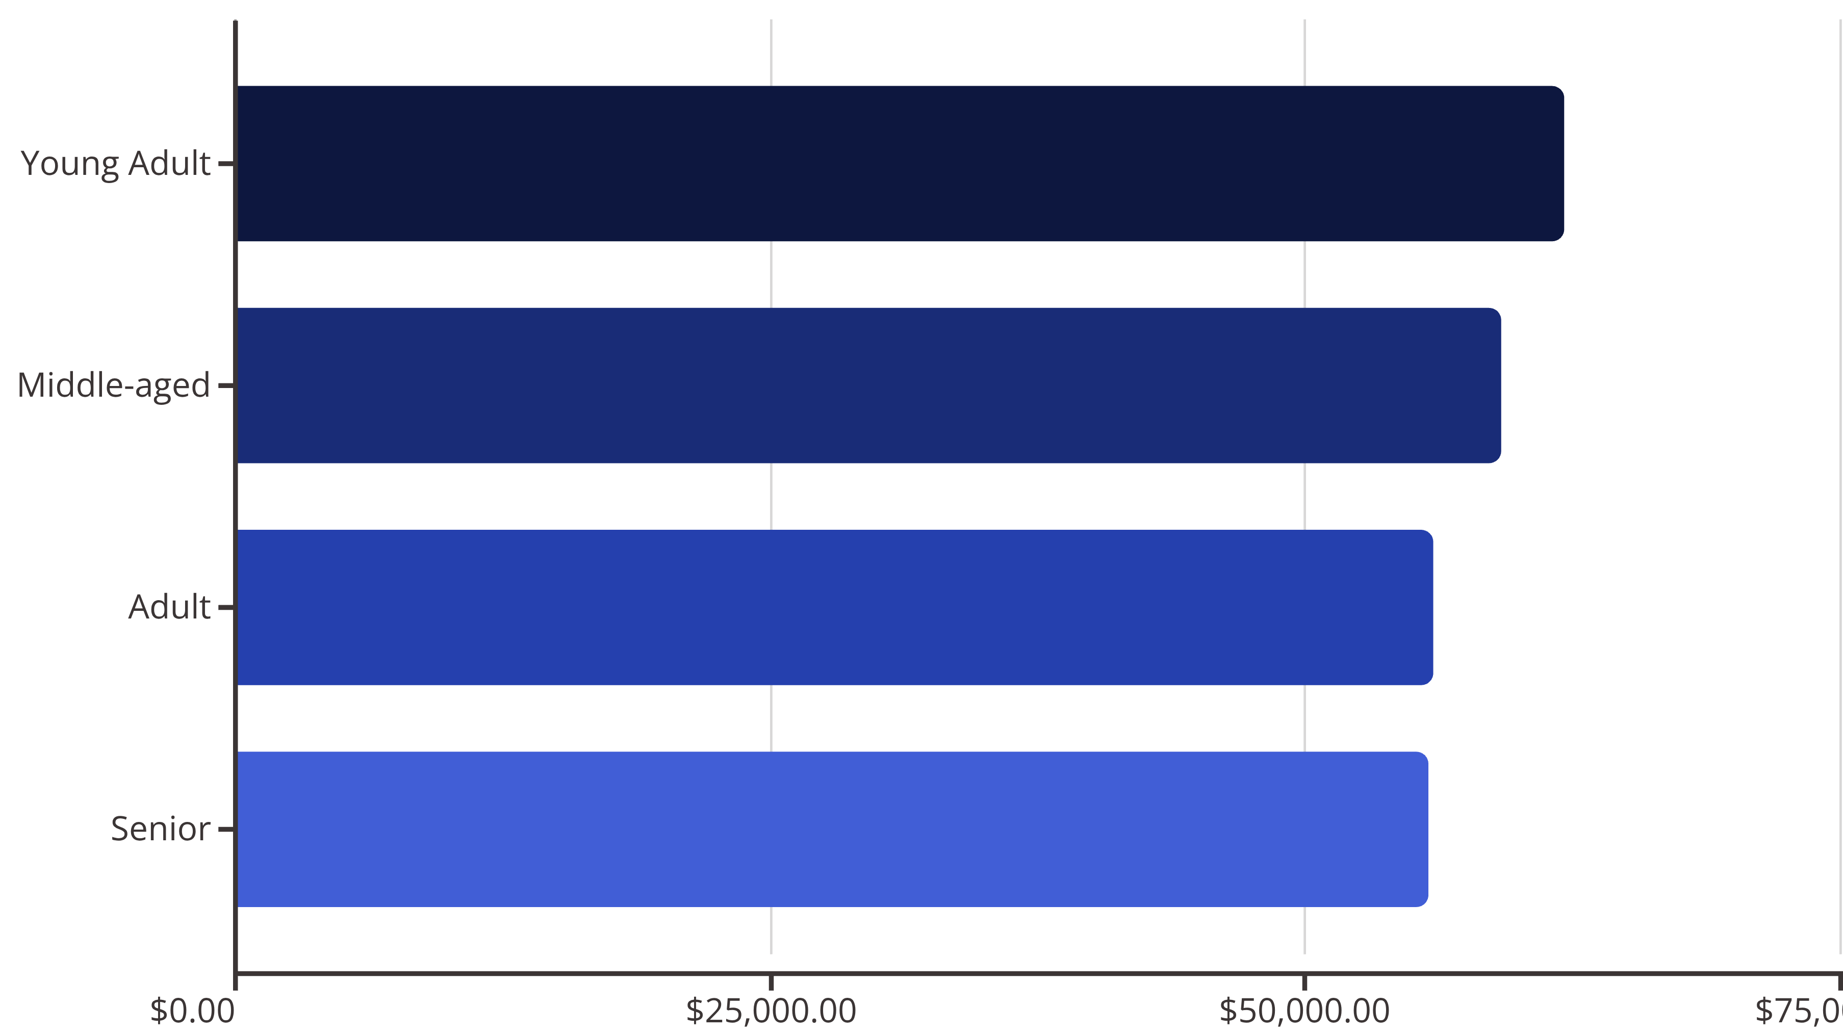
Revenue by Age & Shipping
Shipping Insights
High-Value Discount Users
Express shipping: $60.48 average
839 customers used discounts but spent above average ($59.84)
Standard shipping: $58.46 average
Strategic discounting drives premium purchases
Express users spend 3.5% more per transaction

Slide 10





Strategic Recommendations
Boost Subscriptions
Loyalty Programs
Discount Strategy
Promote exclusive benefits to convert 73% non-subscribers
Reward repeat buyers to move Returning into Loyal segment
Balance sales boosts with margin control on high-discount items
Product Positioning
Targeted Marketing
Highlight top-rated products (Gloves, Sandals, Boots) in campaigns
Focus on Young Adults and express-shipping users for maximum ROI

